Slide 1

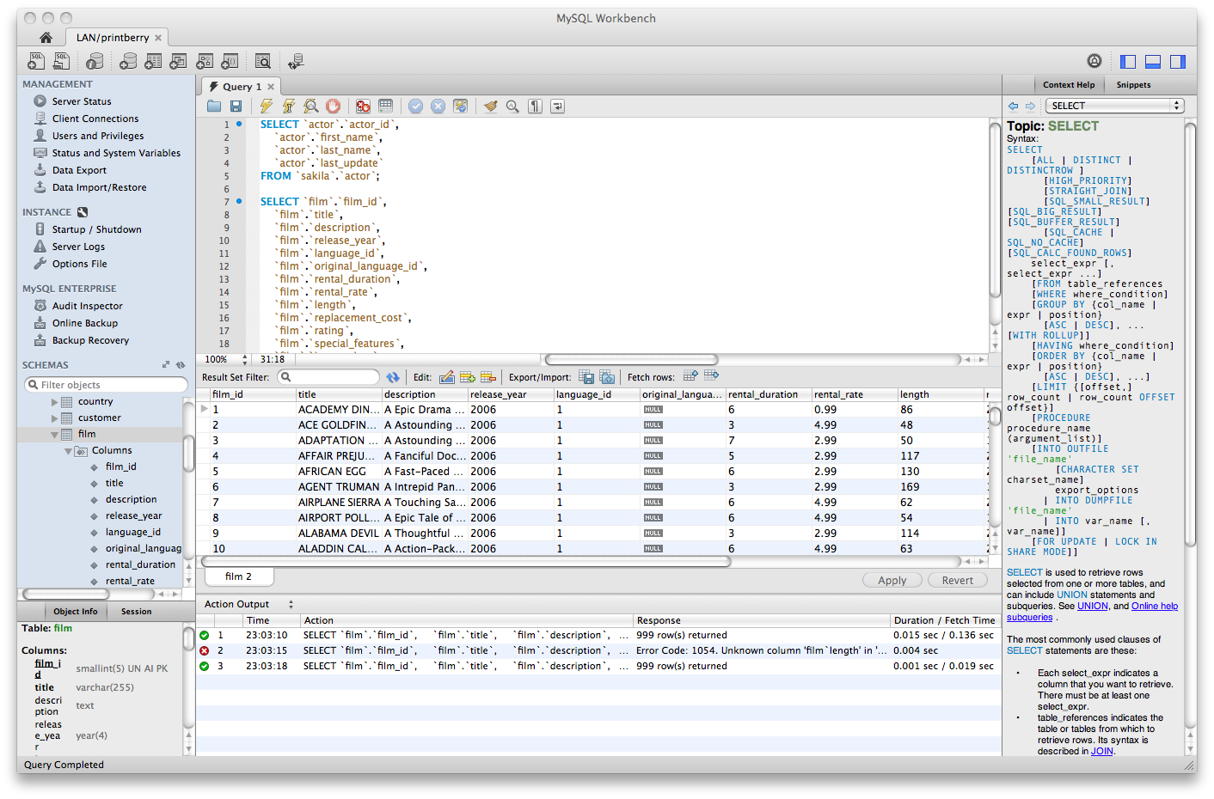
Architecture Enhancement
Full Outer Join Operation

Slide 2
Team
Ante Pimentel
Dusan Birtasevic
Francis Okoyo
Hashim Al-Helli
Richard Van

Slide 3
Outline
Proposal
Implementation
Impacted Subsystems
Testing Plans
Use cases

Slide 4
Proposed Enhancement:
Full Outer Join Operation

Slide 5
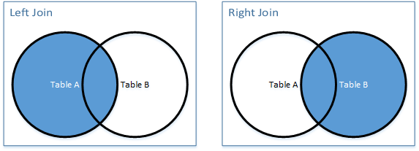
What is a join operation?
Join is an operation that combines two tables based on common columns.
Different types of joins include: left, right, outer and inner joins.

Slide 6
The Problem
The current version of MySQL doesn’t support full outer join operations on tables.
In order to achieve this, the client must emulate it his or herself.
This requires tedious sequences of MySQL statements.

Slide 7
Stakeholders
Clients (Small or large businesses/Corporations, schools, etc.)
Addition of functionality would greatly improve the user experience
Developer
Makes the client happy
Has to implement the change

Slide 8
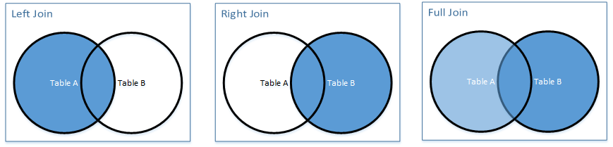
The Solution
Implement a MySQL statement “FULL OUTER JOIN” that will emulate this feature.

Slide 9
Motivation Behind Enhancement
Before:
SELECT column_names FROM table-name1 LEFT JOIN table2 ON column_name1= column_name2 UNION ALL SELECT column_names FROM table_name1 RIGHT JOIN table_name2 ON table_column1 = table_column2 WHERE condition
After:
SELECT column-names FROM table-name1 FULL OUTER JOIN table-name2 ON column-name1 = column-name2 WHERE condition

Slide 10
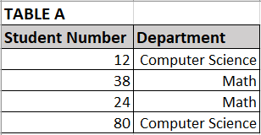
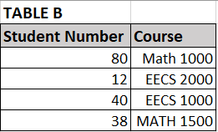
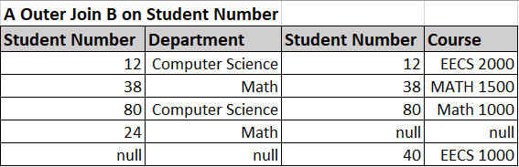
Example

Slide 11
Implementation Approaches

Slide 12
Approach 1 : Combine existing features
Implementation Approaches
This approach simulates full outer join using pre-existing commands.
Given Tables A and B, [(LEFT JOIN B on A) UNION (RIGHT JOIN B on A)].
Overall architecture won’t be affected since no new subsystems are needed.
The components that will need changing are the dml compiler and query parser.
Require changes to dictionary file and sql_resolver.cc to handle new keyword and execution respectively.

Slide 13
Advantages and Disadvantages
Approach 1
Advantages
Faster implementation time.
Less error prone due to reuse of existing well tested functions.
Disadvantages
Have to create an additional class
Changes to existing features may cause the new one to produce wrong output.

Slide 14
Approach 2 : Implement it from scratch
Implementation Approaches
Dive into the MySQL source code and implement the feature from the ground up.
Ensures that every instance of MySQL will have the feature.
Changes to sub-components are the dml compiler and query parser.
Overall architecture remains the same.
Requires changes to dictionary file and sql_resolver.cc to handle new keyword and execution

Slide 15
Implementation using a JOIN Algorithm
Approach 2
Nested-loop Join
Nested loops can be very slow
Sort-Merge Join
Inputs have to be sorted, this can be slow
Steps through both lists, building the output
Hash Join
Build a full hash table in memory
Scans table for matches
Notes:
https://en.wikipedia.org/wiki/Join_%28SQL%29#Full_outer_join

Slide 16
Chosen Implementation: Hash Join
Approach 2
Steps:
Given tables A and B, scan through A and create hash table from A using a hash key based on chosen value
Scan through table B row by row, computing the hash key for each row
Compare A and B according to the hash key
If keys match store rows from each table into a table (Table: Matching)
If keys do not match
For keys in A but not in B, store rows with those keys into a table (Table: A not B)
For keys in B but not in A, store rows with those keys into a table (Table: B not A)
Append tables “A not B” and “B not A” to table “Matching” and return table “Matching”
Notes:
https://en.wikipedia.org/wiki/Hash_join
https://technet.microsoft.com/en-us/library/ms189313(v=sql.105).aspx

Slide 17
Hash Example
Approach 2

Slide 18
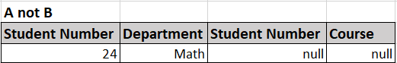
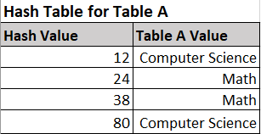
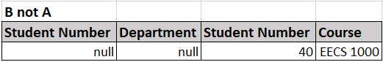
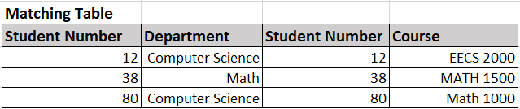
Hash Example:
Approach 2

Slide 19
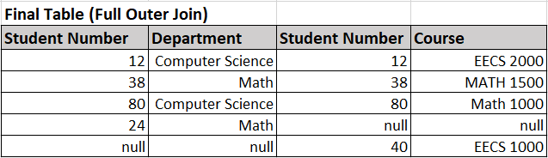
Hash Example:
Approach 2

Slide 20
Advantages and Disadvantages
Approach 2
Advantages
Do not need to sort, faster than Sort-Merge in general
Disadvantages
Entire hash table is stored in memory
If there is not enough space in memory, hash join can be divided into parts (Grace Hash)
Longer and more difficult to implement
Notes:
http://www.dcs.ed.ac.uk/home/tz/phd/thesis/node21.htm

Slide 21
Potential Impact on Subsystems

Slide 22
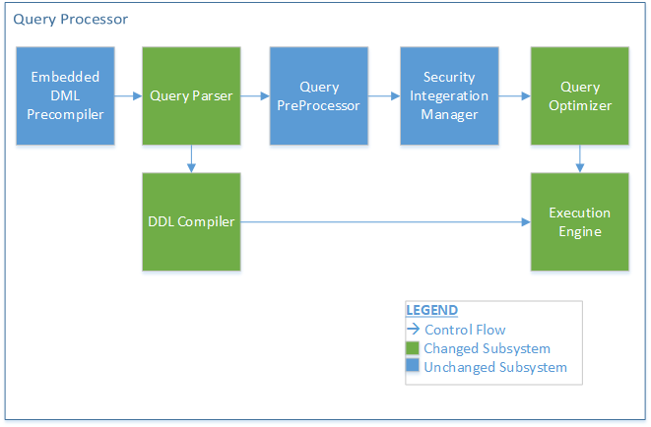
Affected Systems
DML Compiler
Query Parser
Query Optimizer
Execution Engine

Slide 23
Potential Impact on Subsystems
Since the query processor layer is highly coupled the changes won't affect the architecture of MySQL.
Concurrency is preserved because it isn’t touched.
Other features should run just as fine since no architectural alteration is made. I.e adding a new subsystem.

Slide 24
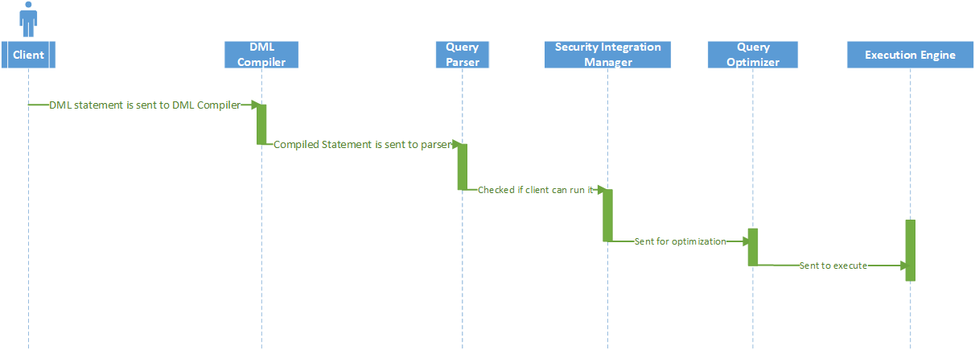
Use cases : Simple Outer Join Statement

Slide 25
Assumptions
We believe that the same interaction between components will exist after we implement the enhancement. This is because we are not adding new subcomponents.

Slide 26
Performance Testing Plan
Time complexity analysis
Run time simulation
Ensure functionality is maintained

Slide 27
Interaction Testing Plan
Use Understand to find out if interactions has been changed.
Use lsedit with our containment file to visualize the interactions if Understand is not available.
Compare the results with our Assumption.

Slide 28
Lessons Learned
Coming up with a feature enhancement for software is difficult without prior knowledge or experience with it.
No matter how small, there is always room for improvement in legacy systems.
Implementing a new feature may have cost (Performance cost, Time cost, etc.).
Most developers do not implement certain features for to efficiency reasons.

Slide 29
Questions?

